Slide 1
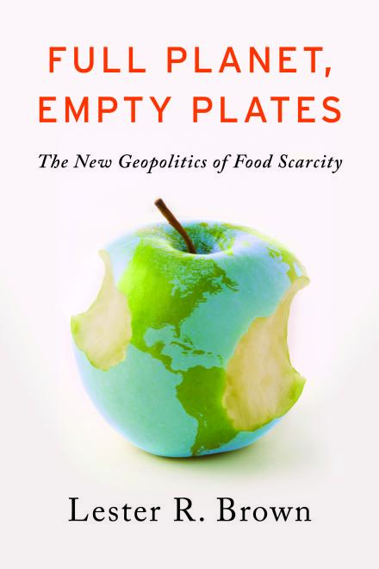

Full Planet,
Empty Plates:
The New Geopolitics of
Food Scarcity
A presentation for
A book by
Lester R. Brown

Slide 2
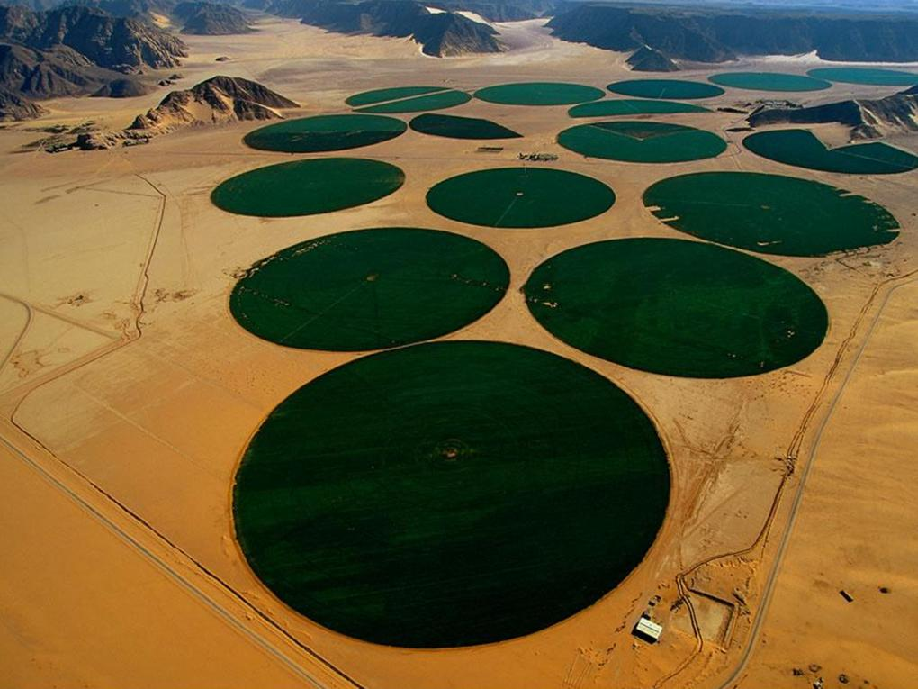
We are entering a time of chronic food scarcity, one that is leading to intense competition for control of land and water resources—in short, a new geopolitics of food.
—Lester R. Brown
Photo Credit: Yann Arthus-Bertrand

Slide 3
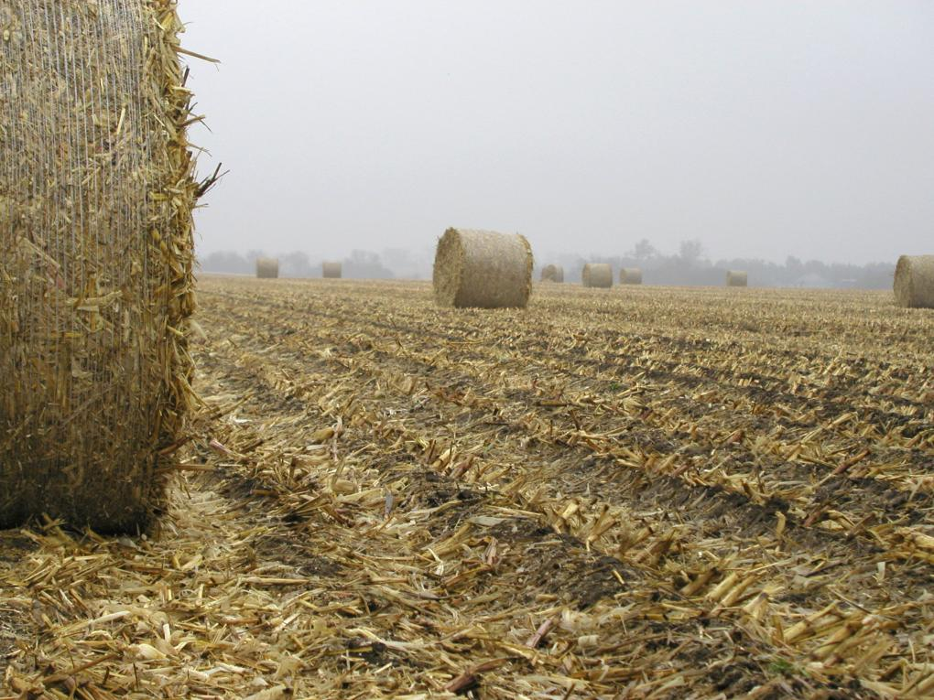
Contents
Food: The Weak Link
The Ecology of Population Growth
Moving Up the Food Chain
Food or Fuel?
Eroding Soils Darkening Our Future
Peak Water and Food Scarcity
Grain Yields Starting to Plateau
Rising Temperatures, Rising Food Prices
China and the Soybean Challenge
The Global Land Rush
Can We Prevent a Food Breakdown?
Photo Credit: USDA/Wally Wilhelm

Slide 4
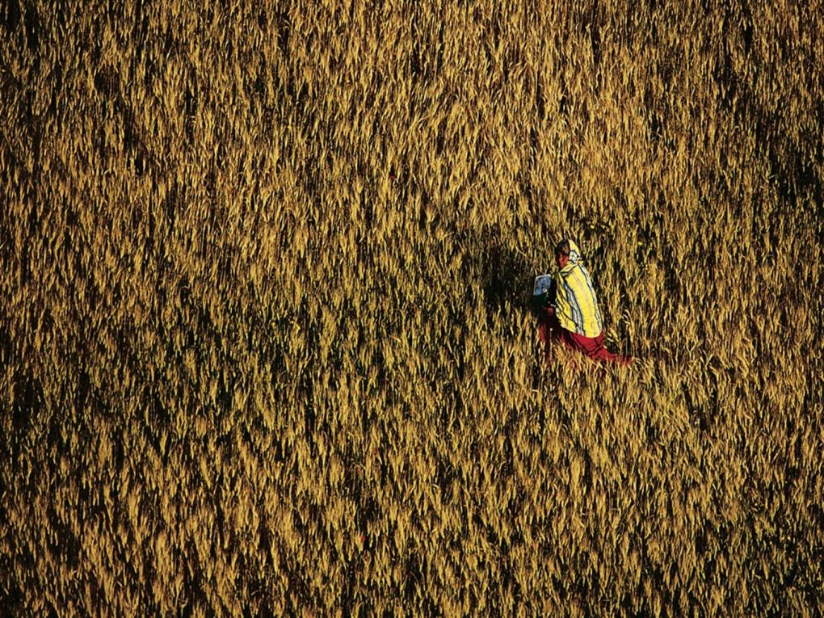
Chapter 1
Food: The Weak Link
Photo Credit: Yann Arthus-Bertrand

Slide 5
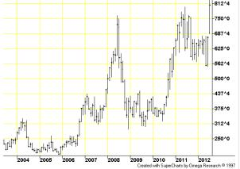
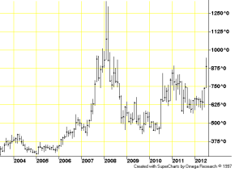
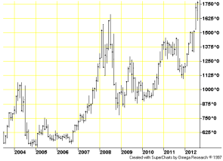
An Era of Rising Food Prices
2007-08: Grain and soybean prices more than doubled, leading to food riots and unrest in some 60 countries
Prices eased somewhat with global recession
2010-11: Another price spike helped fuel the Arab Spring
2012: Prices again approaching or setting records
Corn Futures Prices
Wheat Futures Prices
Soybean Futures Prices
Source: CME Group

Slide 6
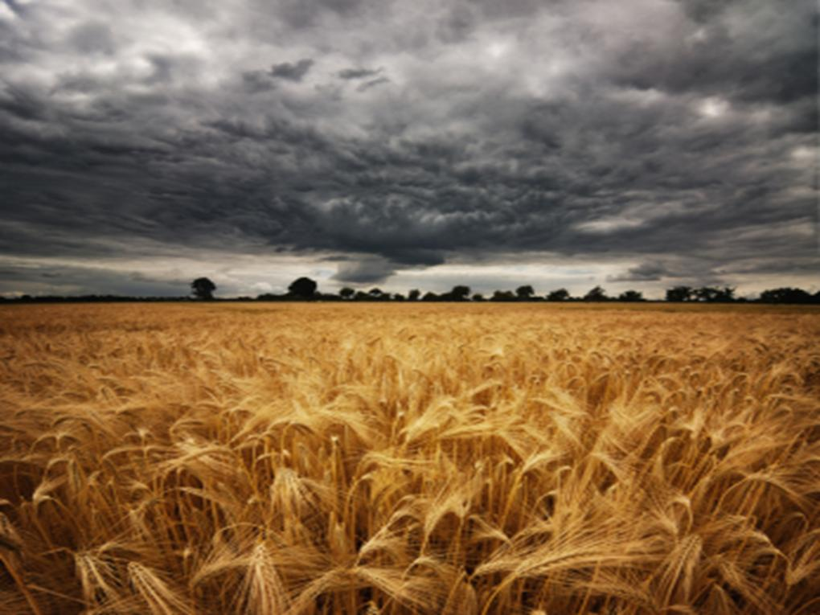
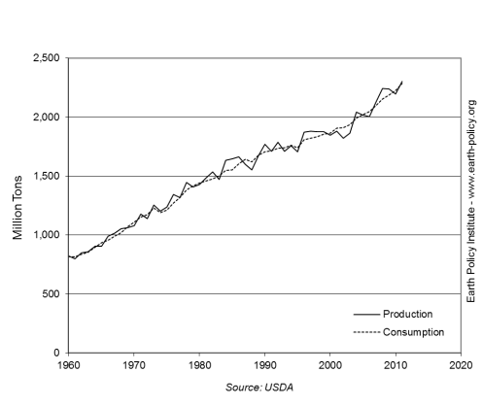
Precarious Global Food Situation
Dangerously small margin between grain consumption and grain production
Now we face long-term trends that:
  increase food demand
  limit food production
World Grain Production and Consumption, 1960-2011
We are only one poor harvest away from chaos in world grain markets.
Photo Credit: iStockPhoto / Tobias Helbig
Notes:
6

Slide 7
Demand Growing, Supply Strained
Demand Side
Supply Side
Growing population
People moving up the food chain
Biofuels turning food into fuel
Eroding soils
Depleting aquifers
Plateauing grain yields
Rising temperature
Photo Credit: iStockPhoto / Tobias Helbig

Slide 8
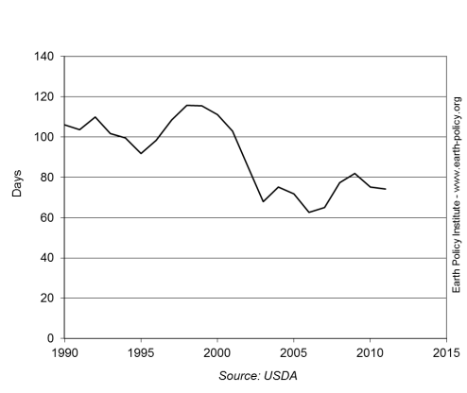
From Surplus to Scarcity
In the past, world had two safety cushions in case of harvest shortfall:
  idled U.S. cropland
  large stocks of grain
Now, we have lost those two safety cushions
  U.S. abandoned cropland set aside programs
  grain stocks have fallen dangerously low
World Grain Stocks as Days of Consumption, 1990-2012
Photo Credit: iStockPhoto / Tobias Helbig

Slide 9
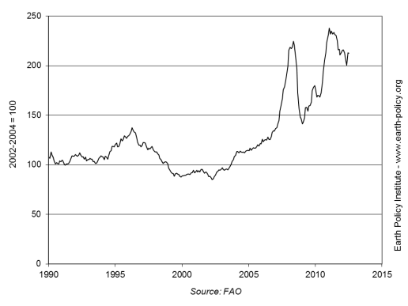
Strained Food Budgets
Rising demand and tightening supply raise world food prices to new heights
For consumers who spend 50–70% of their income on food, higher prices mean eating less
World Monthly Food Price Index, January 1990-August 2012
Photo Credit: iStockPhoto / Tobias Helbig

Slide 10
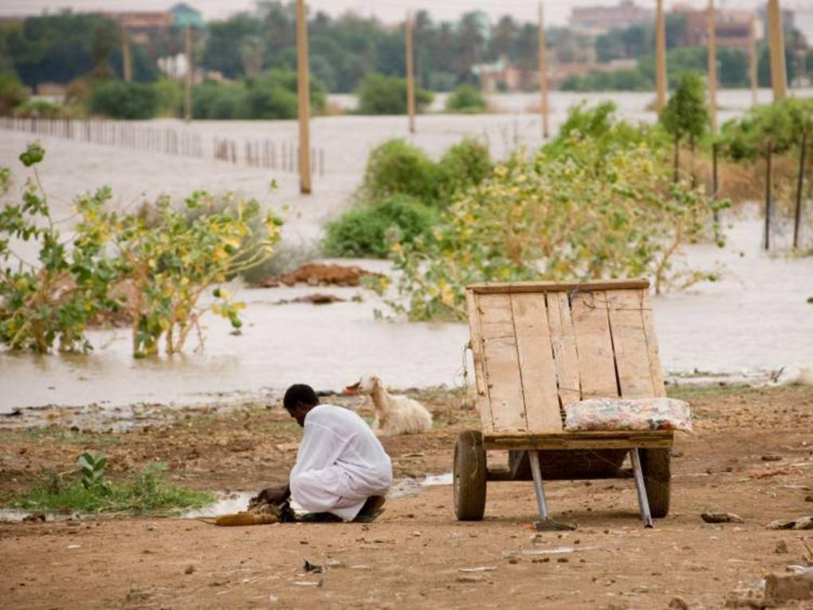
Hunger Rising
Now close to 1 billion people are hungry
Some families have “foodless days” when they do not eat at all
Children suffer the most: some are physically and mentally stunted, unable to reach their full potential
 | Percent of Families with Foodless Days
India | 24
Nigeria | 27
Peru | 14
Source: GlobeScan Inc.
Photo Credit: iStockPhoto / Claudiad
Notes:
10

Slide 11

Learning from the Past
Food shortages undermined ancient civilizations
  Sumer: A flaw in the irrigation system led to rising salt levels in the soil and crop failures
  Maya Empire: forest clearing led to soil erosion and loss of soil fertility
While the decline of early civilizations can be traced to one or two damaging environmental trends, we are now dealing with several. Will we suffer their fate?
Photo Credit: Yann Arthus-Bertrand
Notes:
11

Slide 12
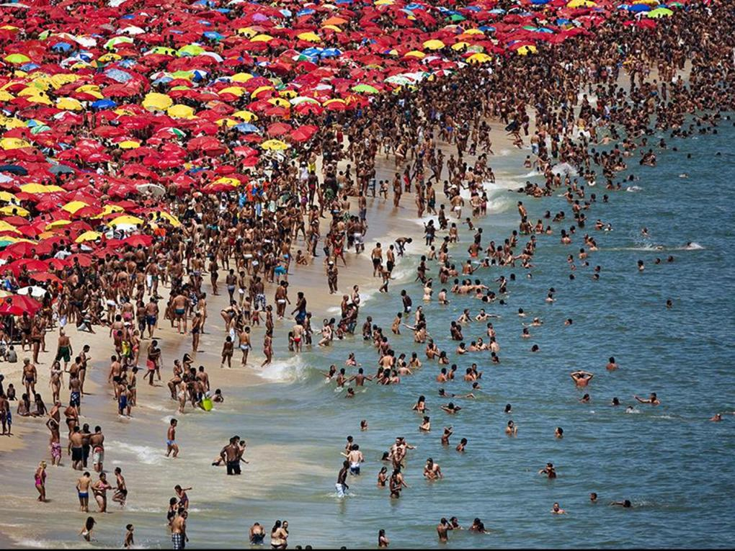
Chapter 2
The Ecology of Population Growth
Photo Credit: Yann Arthus-Bertrand

Slide 13

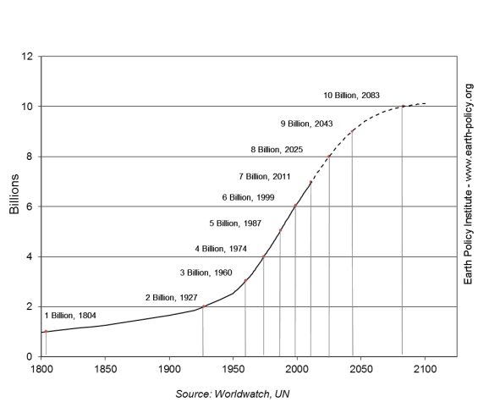
Population Pressures
7 billion people on the planet
Each year, nearly 80 million people added
Some 215 million women who want to plan their families lack access to family planning services
Large families trap people in poverty
World Population, 1800-2010, with Projection to 2100
We are fast outgrowing the earth’s capacity to sustain our increasing numbers.
Photo Credit: Yann Arthus-Bertrand

Slide 14
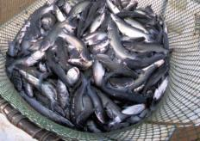
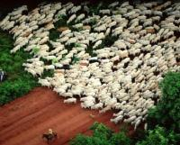
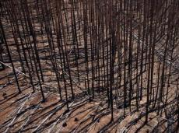
System Overload
Overfishing: 80% of oceanic fisheries are being fished at or beyond their sustainable yield
Overgrazing: The global grazing livestock population grew by 1.2 billion animals since 1960
Overcutting: The world’s forests lose a net 5.6 million hectares—an area the size of Costa Rica—each year
Overplowing: In parts of Africa, Asia, and the Middle East, productive cropland is turning into wasteland
Overpumping: Half the world’s population lives in countries that are extracting groundwater from aquifers faster than it is replenished
Photo Credit: USDA/ Stephen Ausmus; Yann Arthus-Bertrand

Slide 15
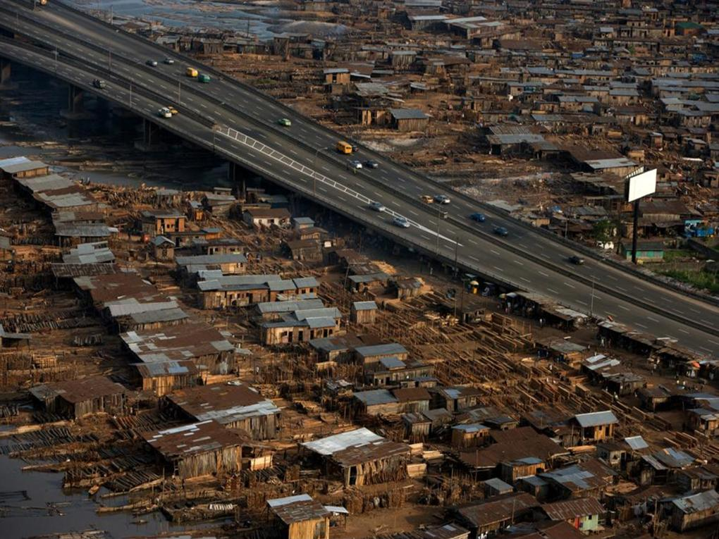
Demographic Transition
High birth rates and low death rates create a demographic trap of rapidly expanding population
  E.g. Nigeria, Ethiopia, Pakistan
  Sub-Saharan Africa and the Indian subcontinent will add nearly 2 billion people by 2050
Countries that reduce both birth and death rates benefit from a demographic bonus
  E.g. Japan, South Korea, Taiwan, Hong Kong, Singapore
  44 countries in Europe, Latin America, and parts of Southeast Asia have reached population stability
Photo Credit: Yann Arthus-Bertrand

Slide 16
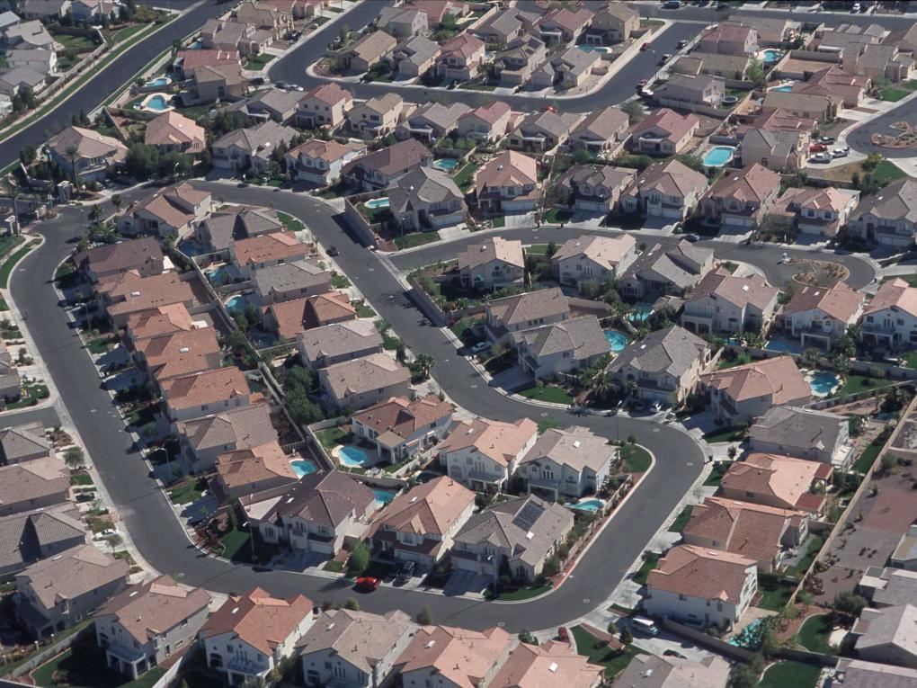
Population Uncertainty
U.N. projections of adding 2.3 billion people by 2050 may not in fact materialize because they do not take into account:
  Resource availability
  Climate variability
  Changing geopolitical (in)stability
Human demands have outrun the carrying capacity of the economy’s natural support systems, leading us toward collapse.
Photo Credit: USDA/ Lynn Betts

Slide 17
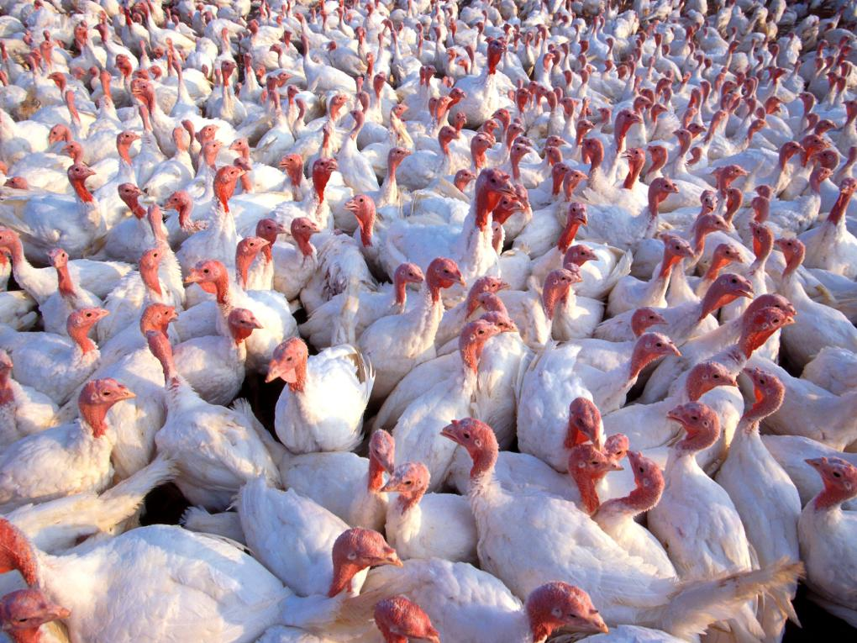
Chapter 3
Moving Up the Food Chain
Photo Credit: USDA / Scott Bauer

Slide 18
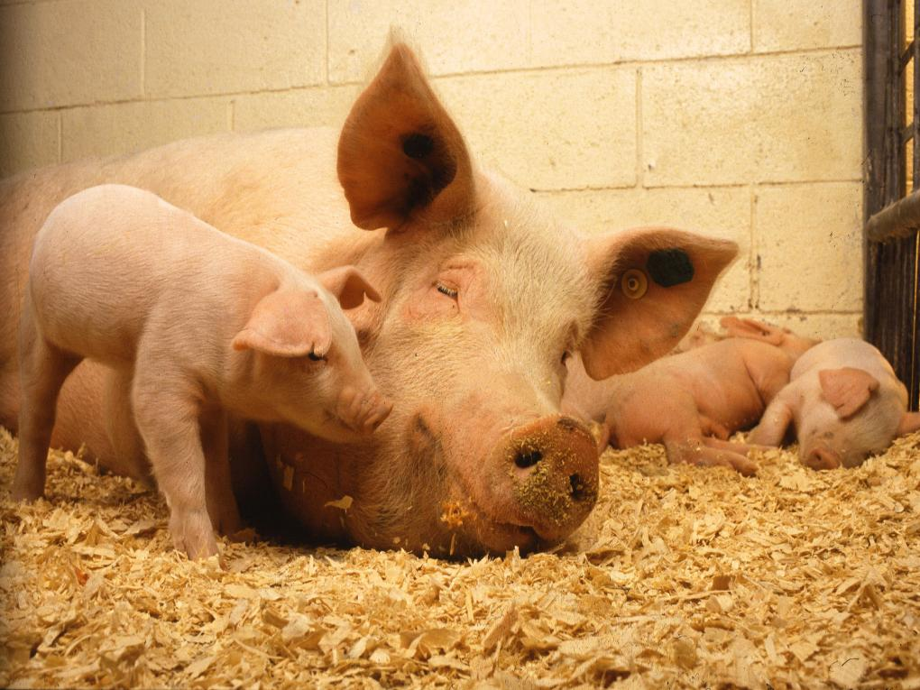
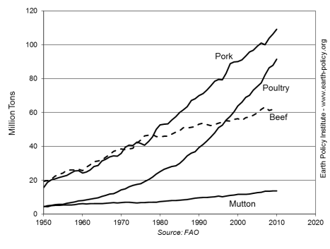
More Meat, More Feed
World meat demand grew fivefold since 1950
As incomes rise, some 3 billion people in the developing world desire to eat more meat, milk, and eggs
This requires more grain and soybeans for animal feed
World Meat Production by Type,
1950-2010
Photo Credit: USDA / Keith Weller

Slide 19
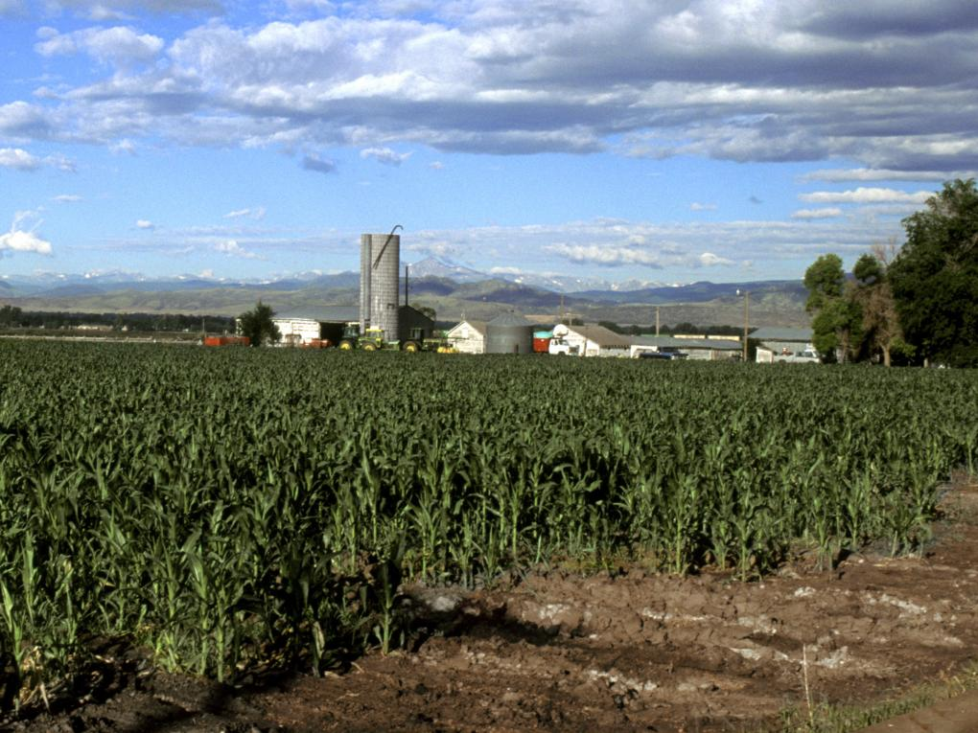
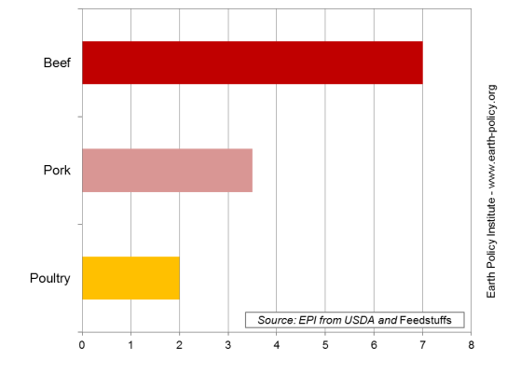
Turning Grain into Animal Protein
Pounds of Grain Fed for Each Pound of Weight Gain
Pound for pound, beef takes more grain than other livestock products, and thus more water, too.
Photo Credit: USDA / Scott Bauer

Slide 20
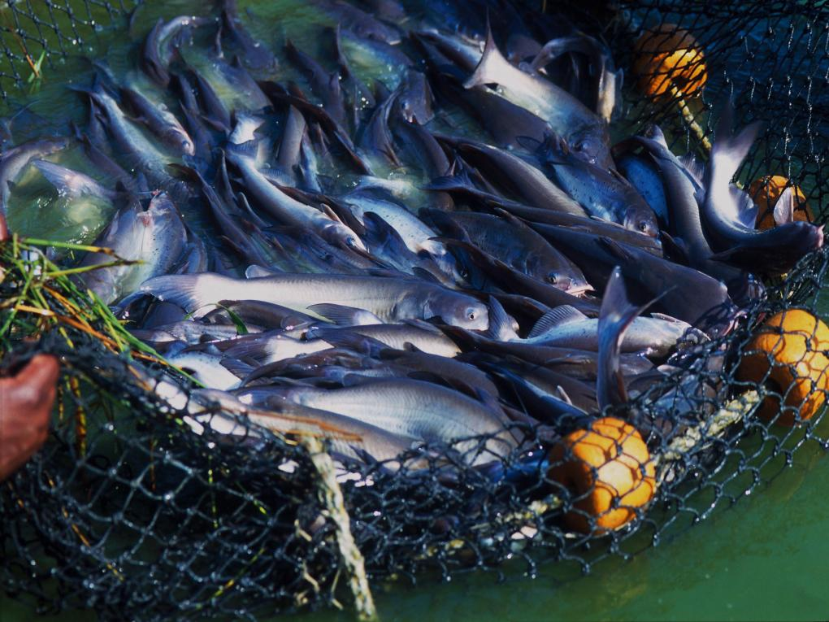
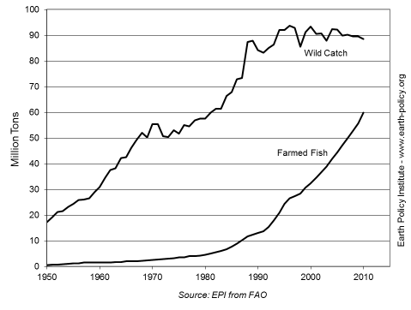
Fish Farming Expands
With most wild fisheries fully or over-exploited, growth in demand for fish now being met by fish farms
Some aquaculture operations use grain and soybeans as feed; others use fish meal, putting additional pressure on oceanic fisheries.
World Wild Fish Catch and Farmed Fish Production, 1961-2010
Photo Credit: USDA / Peggy Greb

Slide 21
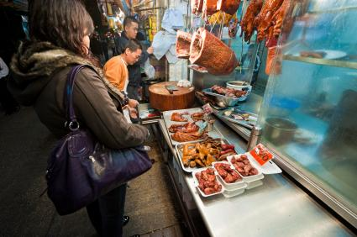
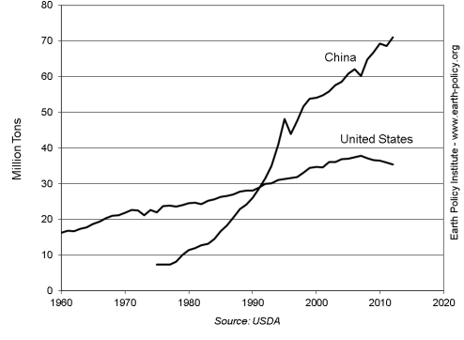
China’s Meat Consumption Rising
China now consumes twice as much meat as the United States
On per capita level, roles are reversed: U.S. consumption per person is twice China’s
Meat Consumption in China and the United States, 1960-2010
As incomes continue to rise, the pressure to produce enough grain and soybeans to satisfy the growing appetite for livestock and poultry products will only intensify.
Photo Credit: iStockPhoto / fotoVoyager

Slide 22
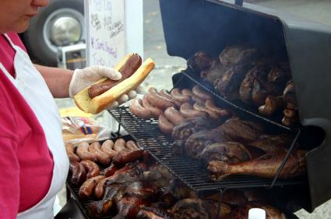
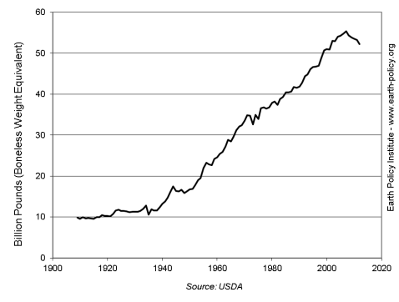
U.S. Meat Consumption Declining
After decades of growth, U.S. meat consumption has peaked
Fell 6% from 2007 to 2012
Benefits of moving down the food chain include better personal and environmental health, plus lower grain and water demand
Meat Consumption in the United States,
1909-2012
Photo Credit: iStockPhoto / Darin Burt

Slide 23
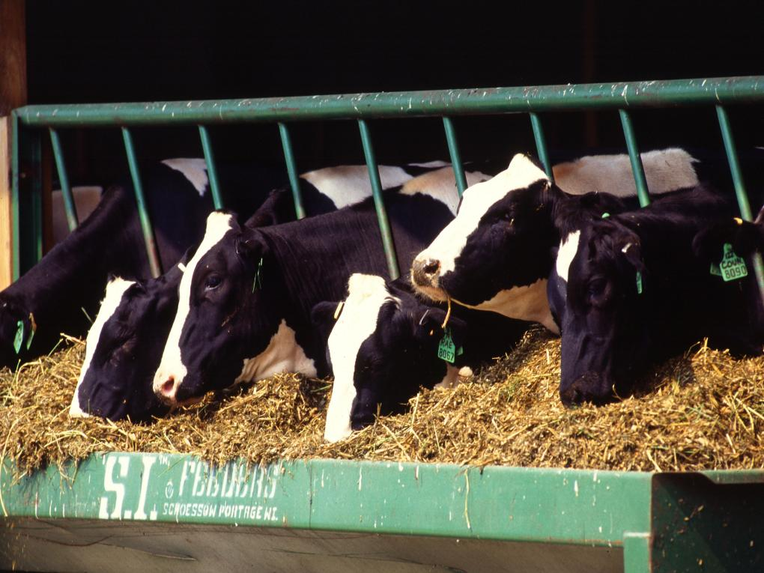
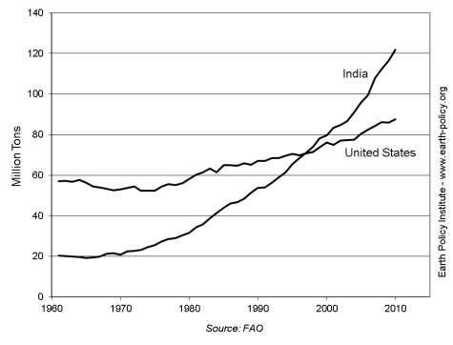
No Grain Needed: India's Dairy Model
In the 1960s, Dr. Verghese Kurien organized an umbrella organization for small milk producer co-ops
India now leads the world in milk production, overtaking the United States in 1997
Cows are fed almost exclusively crop residues and grass
Milk Production in India and the
United States, 1961-2010
Photo Credit: USDA / Scott Bauer

Slide 24
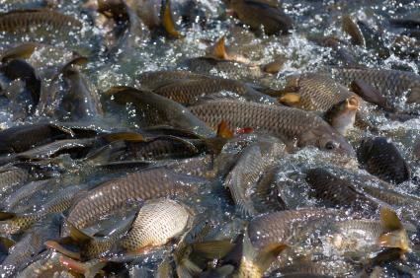
No Grain Needed: Beef and
Farmed Fish in China
Cows in China's "Beef Belt" are fed straw and cornstalks from double-cropped winter wheat and corn fields
Four carp species farmed together in China feed on what they would in the wild (e.g. plankton, aquatic plants); no grain or fish meal involved
Photo Credit: iStockPhoto / Pazhyna

Slide 25
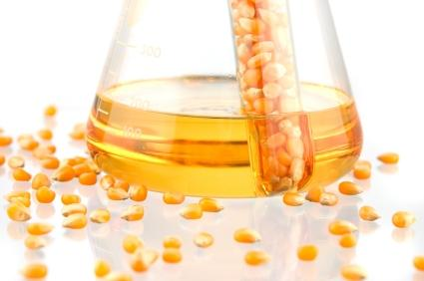
Chapter 4
Food or Fuel?
Photo Credit: iStockPhoto / Vasata Studio

Slide 26

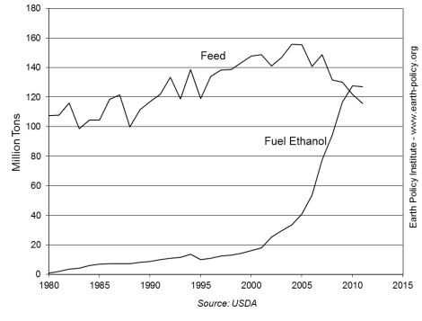
Feeding Cars Instead of People
U.S. corn is largest crop of any grain worldwide, critical to world supplies
Close to 1/3 of U.S. grain now going to ethanol
Grain used to fuel U.S. cars in 2011 could otherwise have fed 400 million people
U.S. ethanol euphoria beginning in 2005 helped raise food prices worldwide
Corn Use for Feed and Fuel Ethanol
in the United States, 1980-2011
The grain needed to fill an SUV’s 25-gallon tank with ethanol once could feed one person for a year.
Photo Credit: USDA / Scott Bauer

Slide 27
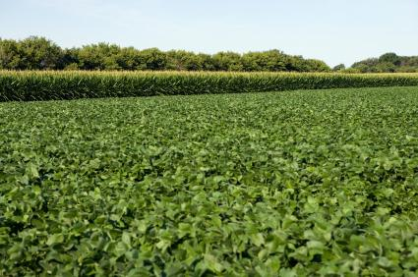
Ethanol Production in Top 10 Countries, 2011
Main ethanol feedstocks:
Corn in United States, China, Canada
Sugarcane in Brazil
Various grains in Europe
Sugarcane and molasses in India, Thailand
Corn-based ethanol is blended into U.S. gasoline to meet “renewable fuels” mandate
 | Million Gallons
United States | 14,319
Brazil | 5,553
China | 555
Canada | 462
France | 301
Germany | 203
India | 147
Thailand | 135
Spain | 122
Belgium | 106
World | 22,742
Source: F.O. Licht
If the entire U.S. grain harvest were turned into ethanol, it would only satisfy 18% of current U.S. gasoline demand.
Photo Credit: iStockPhoto / Bob Randall

Slide 28
Biodiesel Production in Top 10 Countries, 2011
Main biodiesel feedstocks:
Soybeans in United States, Argentina, and Brazil
Rapeseed in Europe
Palm oil in Indonesia, Thailand
E.U. mandate that renewables contribute 10% of transport energy by 2020 coming under fire
 | Million Gallons
United States | 841
Germany | 835
Argentina | 729
Brazil | 698
France | 420
Indonesia | 360
Spain | 188
Italy | 156
Thailand | 156
Netherlands | 117
World | 5,651
Source: F.O. Licht
Photo Credit: iStockPhoto / Bob Randall

Slide 29
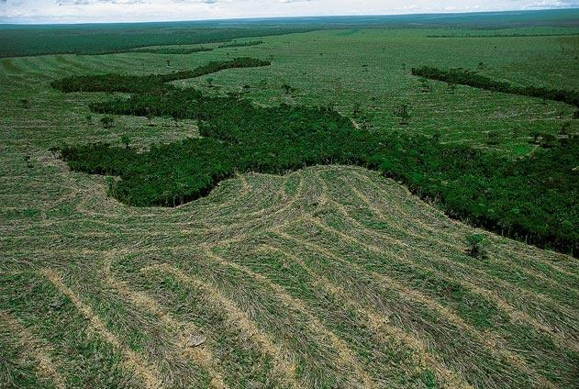
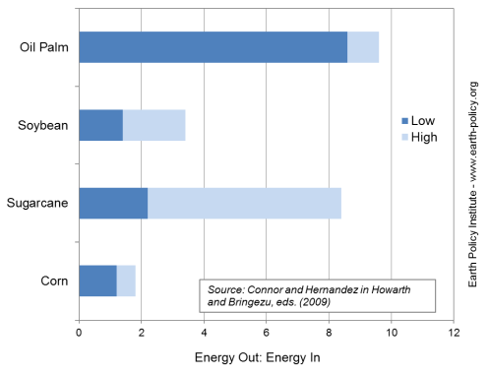
Biofuel Crops Displace Food Crops, Forests
Biofuel crops vary in energy “bang for the buck”
New oil palm plantations come at expense of tropical forests
Greenhouse gas emissions from land use change and fertilizers likely negate climate benefit of replacing gasoline with biofuels
Biofuel Net Energy Ratio for Selected Crops
Photo Credit: Yann Arthus-Bertrand

Slide 30
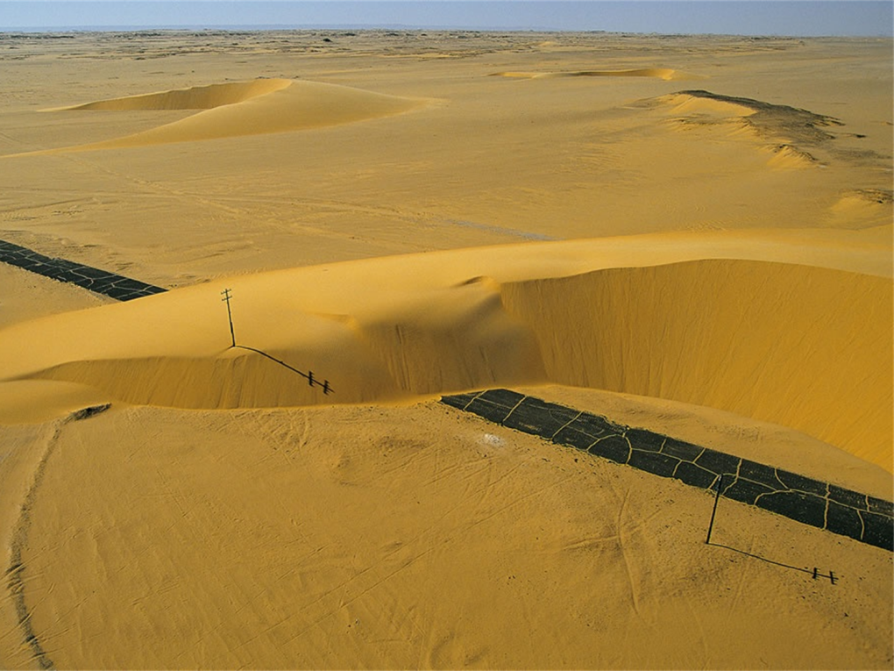
Chapter 5
Eroding Soils Darkening Our Future
Photo Credit: Yann Arthus-Bertrand

Slide 31
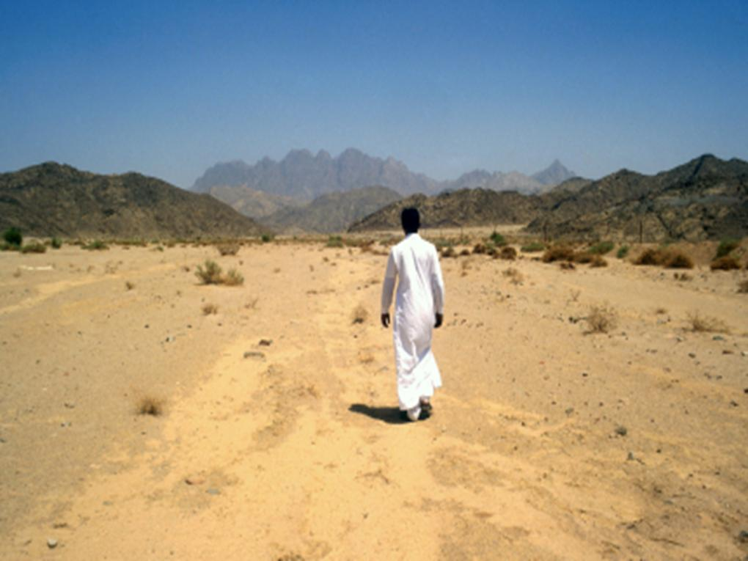
Worsening Soil Erosion
Overplowing, overgrazing, and deforestation make soil vulnerable to wind and water erosion
Roughly 1/3 of the world’s cropland is now losing topsoil faster than it can be re-formed
Topsoil loss reduces productivity, eventually leading farmers and herders to abandon their land
Countries such as Lesotho, Haiti, Mongolia, and North Korea are losing the ability to feed themselves
Photo Credit: iStockPhoto / Steven Allan
Notes:
31

Slide 32
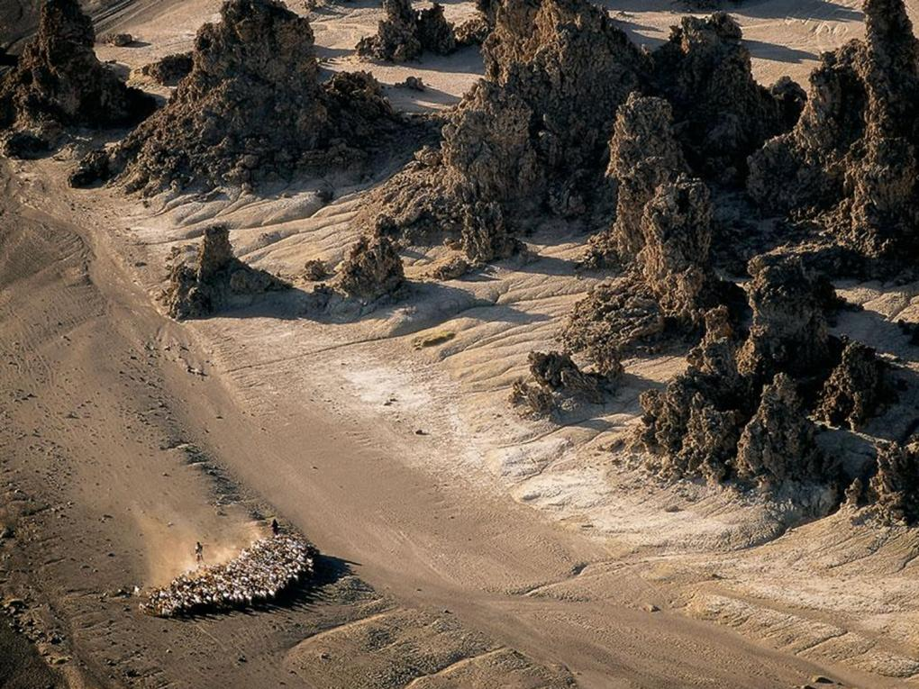
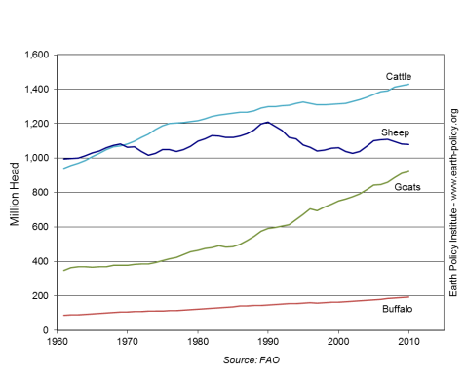
Grazing Livestock Degrading Land
The world’s 3.4 billion cattle, sheep, and goats destroy vegetation, leaving land vulnerable to erosion
Goats thrive in degraded conditions, so growth in their population relative to sheep and cattle is a sign of grassland deterioration
With fast-growing goat numbers, Nigeria is losing 868,000 acres of rangeland and cropland to desertification each year
World Grazing Livestock, 1961-2010
Photo Credit: Yann Arthus-Bertrand

Slide 33
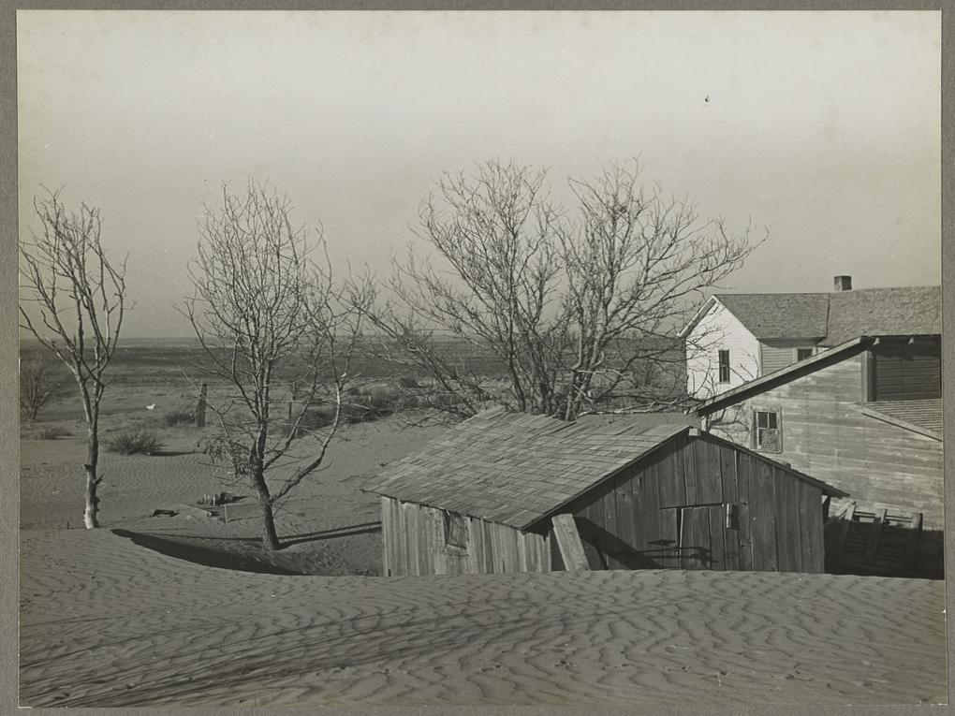
Dust Bowls in History
  Overplowing in the U.S. Great Plains led to the 1930s Dust Bowl that forced the migration of hundreds of thousands of people
  The Soviet Virgin Lands Project converted a massive area of grassland to grainland, resulting in another dust bowl and ultimately cropland abandonment
Photo Credit: U.S. Library of Congress/ Arthur Rothstein

Slide 34
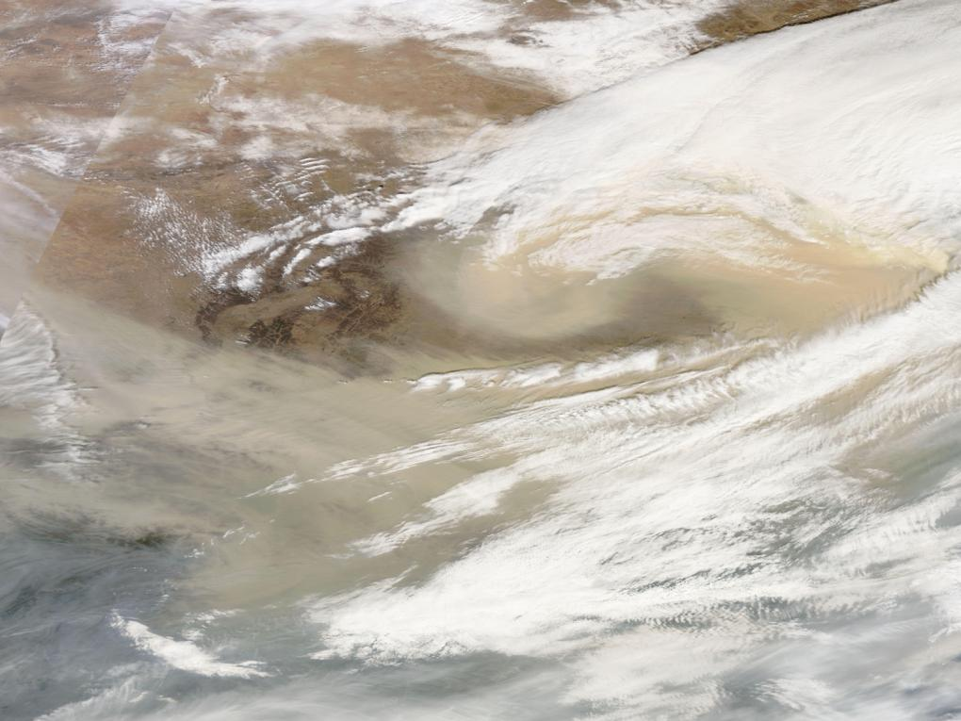
Dust Bowls Today
  Now overgrazing in northwestern China and western Mongolia is leading to the merging of deserts and the formation of dust storms that sweep across the continent, sometimes even as far as North America
  Population and livestock pressure in the African Sahel has destroyed soils; dust storms carrying 2–3 billion tons of soil leave Africa each year
These two newer dust bowls dwarf anything the world has seen before. We have yet to see their full effects.
Photo Credit: NASA Earth Observatory

Slide 35
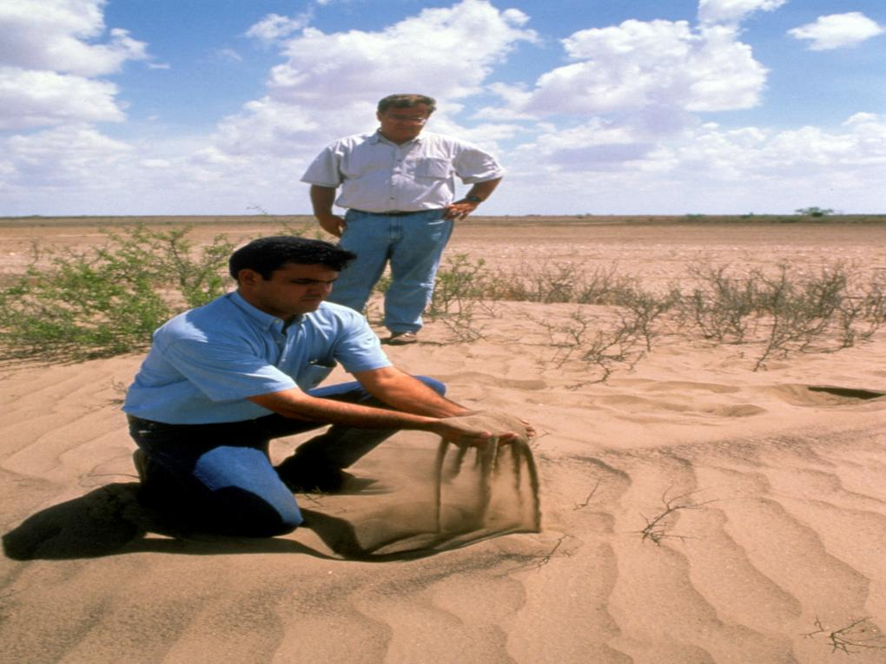
Erosion of Agriculture
The shrinking area of productive land and the earth’s steadily expanding human population are on a collision course. Soil erosion and land degradation issues are local, but the effect on food security is global.
Photo Credit: USDA/ Jack Dykinga

Slide 36
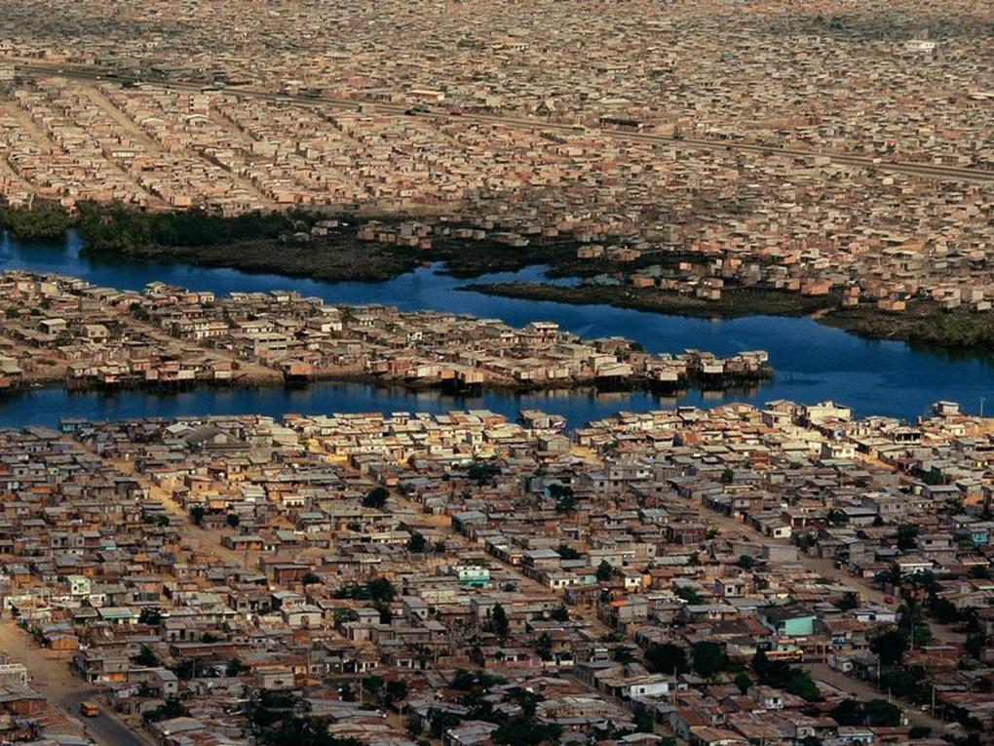
Chapter 6
Peak Water and Food Scarcity
Photo Credit: Yann Arthus-Bertrand

Slide 37
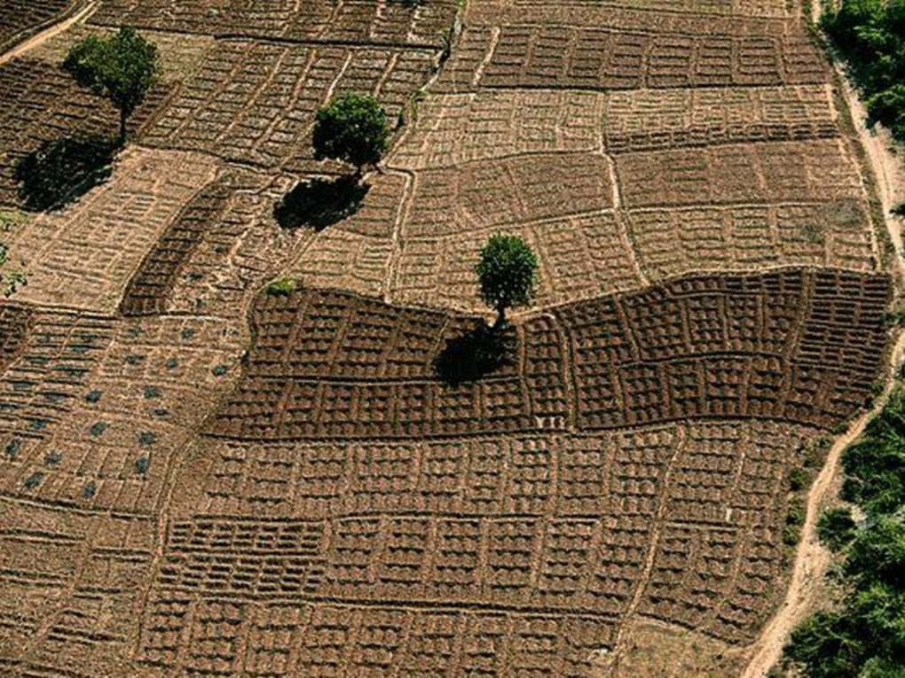
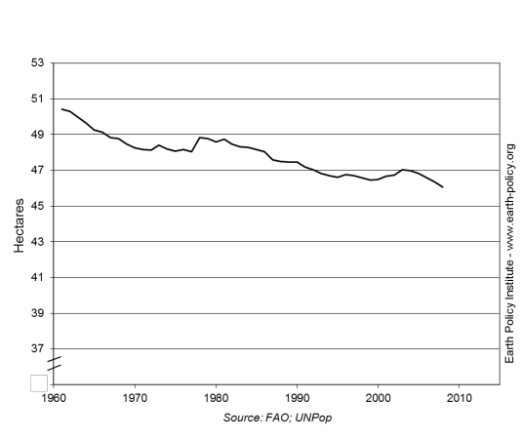
Agriculture’s Water Footprint
Worldwide 70% of water is used for agriculture
Some 40% of the world grain harvest is grown on irrigated land
World Irrigated Area Per Thousand People, 1961-2009
Photo Credit: Yann Arthus-Bertrand

Slide 38
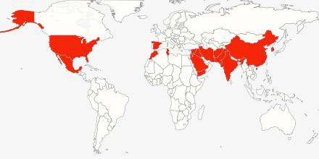
Coming Water Shortages
18 countries, 3.6 billion people
Source: EPI
Overpumping produces food bubbles that burst when water supplies dry up
175 million people in India and 130 million people in China eat grain produced by overpumping
In the Arab Middle East, a collision between population growth and water supply is reducing regional grain harvests

Slide 39
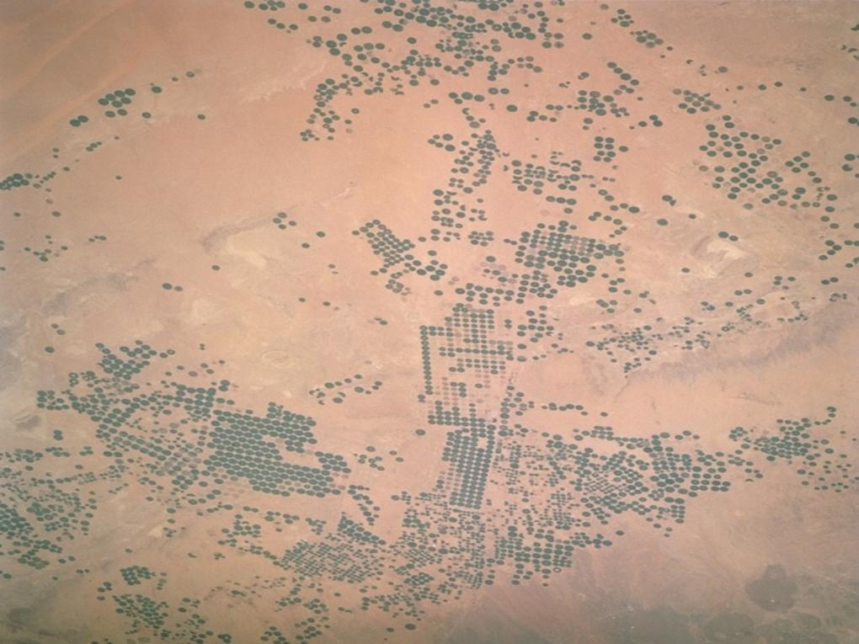

Saudi Arabia’s Bursting Bubble
Saudi Arabia became self-sufficient in wheat by tapping its non-replenishable aquifer to irrigate the desert
In early 2008, the government announced the aquifer was largely depleted
The population of nearly 30 million will be entirely dependent on imported grain by 2016
Wheat Production in Saudi Arabia, 1995-2011, with Projection to 2016
Saudi Arabia is the first country to publicly project how aquifer depletion will shrink its grain harvest.
Photo Credit: NASA

Slide 40

Potential for Conflict
U.S. water withdrawals from the Colorado River cause it to run dry before it reaches Mexico’s Gulf of California
Dam-building projects in Turkey restrict Tigris-Euphrates flow to Syria and Iraq
Foreign land acquisitions for farming in Ethiopia and Sudan will affect the availability of fresh Nile water to Egypt
Dams in China diminish Mekong flow available to Thailand, Viet Nam, and other downstream users
Competition for scarce water resources creates tension on regional and international scales, pitting cities against farmers and countries against each other.
Approximate watershed outlines from EPI, overlaid on map from www.ammap.com

Slide 41

Chapter 7
Grain Yields Starting to Plateau
Photo Credit: iStockPhoto / ollo

Slide 42


Growth in Grain Yields Slowing
World average grain yield has tripled since 1950
But the pace of growth is slowing
  1950-1990: It grew
  2.2% per year
  1990-2011: It grew
  1.3% per year
World Average Grain Yield, 1950-2011
In some of the more agriculturally advanced countries, the increase in grain yields has come to an end.
Photo Credit: iStockPhoto / Simon Oxley

Slide 43


Wheat Yields Flat in Western Europe
Wheat Yields in France, Germany, and the United Kingdom, 1961-2011
Farmers in France, Germany, and the United Kingdom appear to have reached upper biological limits, exhausted the backlog of agricultural technology
They are Western Europe’s leading wheat producers
Wheat yields have plateaued in all three
Together, these three countries produce 80 million tons of wheat per year, 12 % of the world harvest.
Photo Credit: iStockPhoto / img85h

Slide 44


Is China Hitting the Glass Ceiling for Rice?
Japan’s rice yields have not increased in 17 years
South Korea’s rice yields have also plateaued
China’s rice yields are approaching Japan’s, may not be able to surpass them
Rice Yields in Japan and China, 1960-2011
Together, these three countries represent one third of the world rice harvest.
Photo Credit: iStockPhoto / HAIBO BI

Slide 45

Where Else Will Grain Yields Stall?
China’s wheat yields may be approaching a plateau, as with rice
With rising temperatures, farmers everywhere face new climate constraints even as they approach biological limits
Thus far, rice or wheat yields have plateaued only in medium-sized countries. What happens when grain yields plateau in some of the larger ones?
Photo Credit: iStockPhoto / Dave Hughes

Slide 46

Chapter 8
Rising Temperatures, Rising Food Prices
Photo Credit: iStockPhoto / jansmarc

Slide 47


Climate Disruption
The massive burning of fossil fuels is increasing the level of carbon dioxide (CO₂) in the atmosphere, raising the earth’s temperature and disrupting climate
Average Global Temperature and Atmospheric Carbon Dioxide Concentrations, 1880-2012
Photo Credit: Yann Arthus-Bertrand
Notes:
47

Slide 48

Higher Temperatures, Lower Yields
The Intergovernmental Panel on Climate Change projects earth’s average temperature will rise up to 6.4°C (11.5°F) during this century
Current trajectory is already outpacing projections
For every 1°C rise in temperature above the optimum during the growing season, yields of wheat, rice, and corn can be expected to drop 10%
Photo Credit: iStockPhoto / dra_schwartz
Notes:
48

Slide 49

Melting Ice Threatens Food Security
Mountain glaciers are “reservoirs” for many rivers that are a source of irrigation water
  As glaciers disappear, farmers lose this steady source of water
Ice resting on land that melts and runs-off into the oceans raises sea level, threatening rice-growing river deltas
  If the Greenland ice sheet completely melted, sea levels would rise 23 feet
  Just a rise of 3 feet would inundate half the riceland in Bangladesh
Photo Credit: iStockPhoto / jgareri

Slide 50

No More “Normal”
In the past, extreme weather events were anomalies and farmers could expect a return to normal conditions by the next harvest
But with rising temperatures and changing climate, there is no normal to return to
The 11,000 year period of relative climate stability in which agriculture developed is over
Increasing world grain stocks to ~110 days of consumption is one way to create a buffer against extreme weather
With each passing year, the agricultural system is becoming more out of sync with the climate system.
Photo Credit: USDA/Jack Dykinga

Slide 51

2012 Drought Decimates U.S. Corn
Hottest July on record in United States
Drought covered more than 60% of contiguous United States
As the drought and high temperatures damaged the corn and soybean crops, prices for the commodities rose
Climate dice are being loaded,
making such extremes more likely.

Slide 52

Chapter 9
China and the Soybean Challenge
Photo Credit: Yann Arthus-Bertrand

Slide 53


Soybeans Rise to Prominence
Soybeans originated in China 3,000 years ago
Since 1930, soybean meal has been mixed into livestock feed as a source of high-quality protein
Today, the United States, Brazil, and Argentina combined account for over four fifths of the total world production of nearly 250 million tons
World Soybean Production, 1950-2011
Photo Credit: USDA/ Scott Bauer

Slide 54


China Dominates Demand
In 2008, China surpassed the United States as the leading soybean consumer
500 million pigs – half the world total – live in China, eating soybean meal mixed with grain
China currently imports 60% of all soybeans traded internationally
Soybean Production, Consumption, and Imports in China, 1964-2011
As China and other developing countries continue to move up the food chain, this demand will only increase.
Photo Credit: USDA/ Keith Weller

Slide 55


Clearing the Amazon for Soybeans
Raising soybean yields is difficult; most of rise in soybean demand is met by expanding the planted area
In Brazil, this means deforestation in the Amazon Basin and degradation of the savannah-like cerrado
Soybean Area Harvested in the Western Hemisphere, 1960-2011
Protecting these biodiverse, carbon-capturing ecosystems now depends on the world’s more affluent population moving lower on the food chain.
Photo Credit: Yann Arthus-Bertrand

Slide 56

Chapter 10
The Global Land Rush
Photo Credit: iStockPhoto / susoy

Slide 57


New Geopolitics of Food Scarcity
Doubling of grain, soybean prices in 2007-08 revealed a new geopolitics of food—every country for itself:
  Russia, Thailand, other grain exporting countries restricted or banned exports
  Some importers turned to buying or leasing tracts of land in other countries on which to grow food
  These land acquisitions, often called “land grabs,” multiplied quickly
Large-scale Land Acquisitions by Project Type, October 2008 – August 2009
Photo Credit: iStockPhoto / Pawel Gaul

Slide 58

Land Grabs: The Investors
Major investors include China, India, Saudi Arabia, South Korea, and United Arab Emirates
Beyond food security: Some investors—U.S., E.U., Southeast Asian companies—hope to produce biofuel crops
Other investors see land grabbing as a lucrative investment opportunity: Hedge funds, pension funds, university endowments, speculators
Photo Credit: iStockPhoto / BanksPhotos

Slide 59
Land Grabs: The Host Countries
Main targets are sub-Saharan African countries:
  Ethiopia, Sudan, and South Sudan, all emergency food aid recipients
  Also includes Kenya, Mali,Tanzania, and others
  Land often leased for 25 to 99 years for less than $1 per acre per year
Significant interest in Southeast Asia…
  Cambodia, Laos, Philippines, Indonesia
…in Latin America…
  Brazil, Argentina
…and the former Soviet Union
  Russia, Kazakhstan, Ukraine
Photo Credit: iStockPhoto / Bob Randall

Slide 60

Selected Examples of Land Deals
Target Country | Description
Brazil | China’s Chongqing Grain Group reportedly harvesting soybeans on some 500,000 acres in Bahia state
Cambodia | Singapore-based HLH Group farming corn on 35,000-acre, 70-year lease
Ethiopia | Saudi billionaire’s agribusiness firm leasing 24,700 acres for rice in Gambella region; plans to obtain another 716,000 acres
Russia | South Korea’s Hyundai Heavy Industries growing corn, oats, wheat, and soybeans to ship home on two farms totaling 40,000 acres
Photo Credit: iStockPhoto / zoran simin

Slide 61

Ethiopia as Microcosm
Farmers, indigenous people often find out about deals only as they are forced from their land
  By early 2012, more than 1 million Ethiopians forcibly relocated by their government
Informal land rights make it difficult for people to protest
Projects using highly-mechanized, industrial agriculture; few jobs for local people
Food produced most often shipped to investor’s home country, contributing nothing to the local food supply
Land grabs for agriculture are also necessarily water grabs
Photo Credit: iStockPhoto / BanksPhotos

Slide 62
The Land Rush Is On
As more land is acquired and local people are deprived of jobs and land, ranks of the hungry may swell
Hostility of local people to land grabs is the rule, not the exception
Rising political instability is a serious concern—may contribute to already growing list of failing states
These land acquisitions are an integral part of a global power struggle for control of the earth’s land and water resources.
Photo Credit: iStockPhoto / Bob Randall

Slide 63

Chapter 11
Can We Prevent a Food Breakdown?
Photo Credit: Yann Arthus-Bertrand

Slide 64

Toward a More Stable Food System
Demand Side
Supply Side
Stabilize population
Eradicate poverty
Reduce excessive meat consumption
Eliminate biofuels mandates
Conserve soil
Increase water productivity
Fill the yield gap
Stabilize climate
If we tackle both sides of the food equation, we can rebuild world grain stocks, improving food security.
Photo Credit: iStockPhoto / Niko Vujevic

Slide 65


Stabilizing Population and Eradicating Poverty
School lunch programs help children, especially girls, stay in school
Girls who stay in school longer are likely to have fewer children
Reducing family size helps lift families out of poverty
Malnutrition is found less often in smaller families
Female Secondary Education and Total Fertility Rates
Efforts to eliminate poverty and slow population growth reinforce each other.
Photo Credit: iStockPhoto / Viorika
Notes:
65

Slide 66


Supply Solutions
Soil Conservation Measures
Return highly erodible land to grass
Terracing
Plant tree shelterbelts
Strip cropping
No-till farming
Terracing
Photo Credit: Yann Arthus-Bertrand
No-till farming
Photo Credit: USDA ARS
Photo Credit: USDA/Dave Clark

Slide 67

Supply Solutions
Water Conservation Measures
Use more efficient irrigation techniques (e.g. drip irrigation)
Use more water-efficient crops, such as wheat instead of rice
Move down the food chain
Price water to encourage efficiency
Recycle water
Drip Irrigation
Photo Credit: USDA/Pete Mortimer
Photo Credit: USDA ARS

Slide 68


Case Study: Raising
Grain Yields in Malawi
2005 drought left many people hungry or starving
Government, with international support, provided farmers fertilizer and seed subsidies
Corn harvest nearly doubled in 2 years; farmers’ incomes grew and they were able to export some grain
Corn Yields in Malawi, 1961-2011
With economic incentives and access to modern inputs, farmers in sub-Saharan Africa can easily double yields.
Photo Credit: iStockPhoto / Sharon Day

Slide 69

Stabilize Climate
Need to cut carbon emissions 80% worldwide
Spur shift to clean energy economy by restructuring taxes to incorporate indirect costs of fossil fuels
  Increase carbon taxes, reduce income taxes
Eliminate fossil fuels subsidies
Time is our scarcest resource.
Photo Credit: iStockPhoto / pamspix

Slide 70

Plan B Carbon Dioxide Emissions
Reduction Goals

Slide 71


Harnessing the Wind
Centerpiece of Plan B energy economy
Growing number of places get a large share of electricity from wind:
  Germany: 4 states over 45%
  Denmark: more than 25% nationally
  United States:
  South Dakota and Iowa ~ 20%
World Cumulative Installed Wind Power Capacity, 1980-2011
Photo Credit: iStockPhoto / monap

Slide 72


Solar Power Heating Up
Sunlight hitting the earth in 1 hour could power global economy for 1 year
Solar power in Europe can now satisfy the electricity needs of some 15 million households
With 24,700 MW of PV, Germany has twice as much solar installed as number two Italy
World Cumulative Solar Photovoltaics
Installations, 1998-2011
Photo Credit: iStockPhoto / manwolste

Slide 73


Geothermal: Energy from the Earth
Kenya now gets one fifth of its electricity from geothermal energy
Indonesia is shooting for 9,500 megawatts of geothermal generating capacity by 2025, which would meet 56% of current electricity needs
Potential geothermal capacity worldwide could power the entire world economy nearly two times over
World Cumulative Installed Geothermal Power Capacity, 1950-2010
Photo Credit: iStockPhoto / Animean

Slide 74


Restructuring Transport
U.S. Motor Gasoline Consumption,
1950-2012
Cities emphasizing rail and bus rapid transit need fewer cars
Plug-in hybrid and all-electric vehicles can run primarily on emissions-free electricity
Good news: U.S. gasoline use dropped 11% from 2007 peak to 2012, trend likely to continue
Photo Credit: iStockPhoto / mm88

Slide 75

Redefining Security
Historically, security has been defined mostly in military terms
But today climate volatility, emerging water shortages, spreading hunger, and failing states are the new threats to survival
Food security is not just in the hands of agricultural departments
The challenge is to reorder fiscal priorities to match these new dangers
Photo Credit: Yann Arthus-Bertrand

Slide 76

A Wartime Mobilization
We have the technologies necessary to prevent a food breakdown– what is needed now is the political will to do so
Saving civilization will require urgent action on a large scale, but we’ve mobilized quickly before
Upon entering World War II, the U.S. mobilized resources and completely restructured its economy within months
Photo Credit: Yann Arthus-Bertrand

Slide 77

Let’s Get to Work
Saving civilization is not a spectator sport.
—Lester R. Brown
Preventing a food breakdown requires a huge political effort undertaken on many fronts and with a fierce sense of urgency
Make sure your elected officials know what’s important
  The overriding priority is redefining security and reallocating fiscal resources accordingly
Take action in an area that concerns or excites you
Photo Credit: iStockPhoto / kryczka
Notes:
77

Slide 78

To learn more about this mobilization…
read World on the Edge by Lester R. Brown. More information and full-text copies of our publications are available at
www.earth-policy.org
Notes:
78

Slide 79
To learn more about the global food situation…
read Full Planet, Empty
Plates: The New Geopolitics
of Food Scarcity by
Lester R. Brown. The book and supporting data sets are available at
www.earth-policy.org
Notes:
79

